Slide 1
Equivalence Relations
Section 9.5

Slide 2
Section Summary
Equivalence Relations
Equivalence Classes
Equivalence Classes and Partitions

Slide 3
Equivalence Relations
Definition 1: A relation on a set A is called an equivalence relation if it is reflexive, symmetric, and transitive.
Definition 2: Two elements a, and b that are related by an equivalence relation（等价关系） are called equivalent. The notation a ∼ b is often used to denote that a and b are equivalent elements with respect to a particular equivalence relation.

Slide 4
Strings
Example: Suppose that R is the relation on the set of strings of English letters such that aRb if and only if l(a) = l(b), where l(x) is the length of the string x. Is R an equivalence relation?
Solution: Show that all of the properties of an equivalence relation hold.
  Reflexivity: Because l(a) = l(a), it follows that aRa for all strings a.
  Symmetry: Suppose that aRb. Since l(a) = l(b), l(b) = l(a) also holds and bRa.
  Transitivity: Suppose that aRb and bRc. Since l(a) = l(b),and l(b) = l(c), l(a) = l(a) also holds and aRc.

Slide 5
Congruence Modulo m
Example: Let m be an integer with m > 1. Show that the relation
R = {(a,b) | a ≡ b (mod m)}
is an equivalence relation on the set of integers.
Solution: Recall that a ≡ b (mod m) if and only if m divides a − b.
  Reflexivity: a ≡ a (mod m) since a − a = 0 is divisible by m since 0 = 0 ∙ m.
  Symmetry: Suppose that a ≡ b (mod m). Then a − b is divisible by m, and so a − b = km, where k is an integer. It follows that b − a = (− k) m, so b ≡ a (mod m).
  Transitivity: Suppose that a ≡ b (mod m) and b ≡ c (mod m). Then m divides both a − b and b − c. Hence, there are integers k and l with a − b = km and b − c = lm. We obtain by adding the equations:
  a − c = (a − b) + (b − c) = km + lm = (k + l) m.
  Therefore, a ≡ c (mod m).

Slide 6
Divides
Example: Show that the “divides” relation on the set of positive integers is not an equivalence relation.
Solution: The properties of reflexivity, and transitivity do hold, but there relation is not transitive. Hence, “divides” is not an equivalence relation.
  Reflexivity: a ∣ a for all a.
  Not Symmetric: For example, 2 ∣ 4, but 4 ∤ 2. Hence, the relation is not symmetric.
  Transitivity: Suppose that a divides b and b divides c. Then there are positive integers k and l such that b = ak and c = bl. Hence, c = a(kl), so a divides c. Therefore, the relation is transitive.

Slide 7
Equivalence Classes
Definition 3: Let R be an equivalence relation on a set A. The set of all elements that are related to an element a of A is called the equivalence class （等价类） of a. The equivalence class of a with respect to R is denoted by [a]_{R}.
When only one relation is under consideration, we can write [a], without the subscript R, for this equivalence class.
Note that [a]_{R} = {s|(a,s) ∈ R}.
If b ∈ [a]_{R}, then b is called a representative of this equivalence class. Any element of a class can be used as a representative of the class.
The equivalence classes of the relation congruence modulo m are called the congruence classes modulo m（以m为模的同余类）. The congruence class of an integer a modulo m is denoted by [a]_{m}, so [a]_{m} = {…, a−2m, a−m, a+2m, a+2m, … }. For example,
  [0]₄ = {…, −8, −4 , 0, 4 , 8 , …} [1]₄ = {…, −7, −3 , 1, 5 , 9 , …}
  [2]₄ = {…, −6, −2 , 2, 6 , 10 , …} [3]₄ = {…, −5, −1 , 3, 7 , 11 , …}

Slide 8
Equivalence Classes and Partitions
Theorem 1: let R be an equivalence relation on a set A. These statements for elements a and b of A are equivalent:
  (i) aRb
  (ii) [a] = [b]
  (iii) [a] ∩ [b] = ∅
  Proof: We show that (i) implies (ii). Assume that aRb. Now suppose that c ∈ [a]. Then aRc. Because aRb and R is symmetric, bRa. Because R is transitive and bRa and aRc, it follows that bRc. Hence, c ∈ [b]. Therefore, [a]⊆ [b]. A similar argument (omitted here) shows that [b]⊆ [a]. Since [a]⊆ [b] and [b]⊆ [a], we have shown that [a] = [b].
(see text for proof that (ii) implies (iii) and (iii) implies (i))

Slide 9
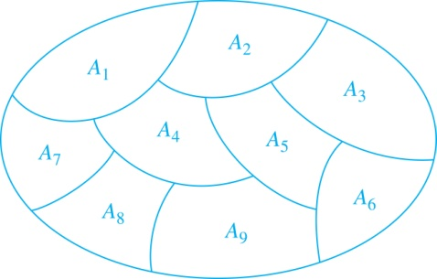
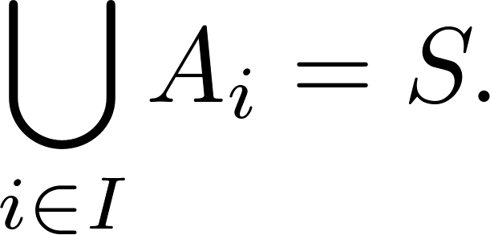
Partition of a Set
Definition: A partition of a set S is a collection of disjoint nonempty subsets of S that have S as their union. In other words, the collection of subsets A_{i}, where i ∈ I (where I is an index set), forms a partition of S if and only if
  A_{i} ≠ ∅ for i ∈ I,
  A_{i} ∩ A_{j}=∅ when i ≠ j,
  and
A Partition of a Set

Slide 10
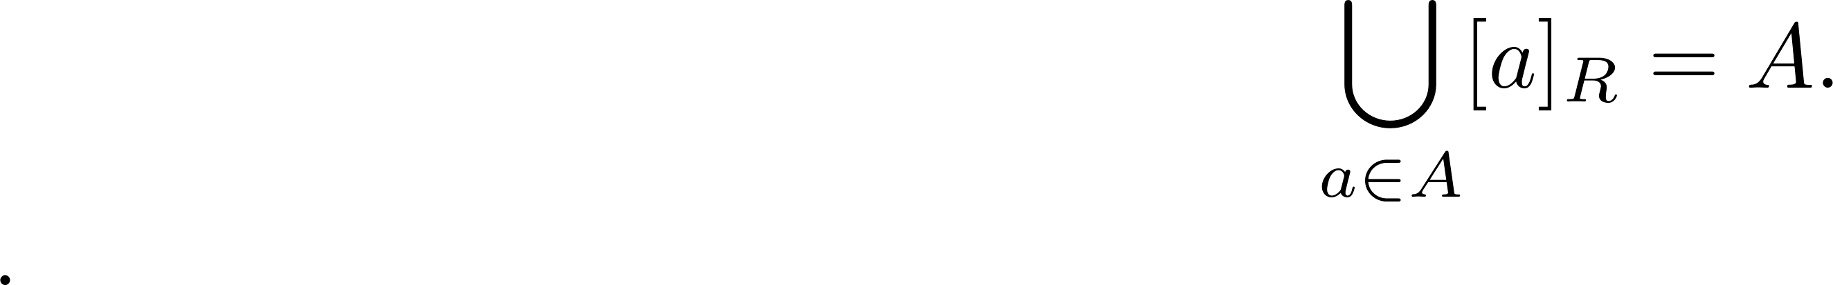
An Equivalence Relation Partitions a Set
Let R be an equivalence relation on a set A. The union of all the equivalence classes of R is all of A, since an element a of A is in its own equivalence class [a]_{R}. In other words,
From Theorem 1, it follows that these equivalence classes are either equal or disjoint, so [a]_{R} ∩[b]_{R}=∅ when [a]_{R} ≠ [b]_{R}.
Therefore, the equivalence classes form a partition of A, because they split A into disjoint subsets.

Slide 11
An Equivalence Relation Partitions a Set (continued)
Theorem 2: Let R be an equivalence relation on a set S. Then the equivalence classes of R form a partition of S. Conversely, given a partition {A_{i} | i ∈ I} of the set S, there is an equivalence relation R that has the sets A_{i}, i ∈ I, as its equivalence classes.
Proof: We have already shown the first part of the theorem.
For the second part, assume that {A_{i} | i ∈ I} is a partition of S. Let R be the relation on S consisting of the pairs (x, y) where x and y belong to the same subset A_{i} in the partition. We must show that R satisfies the properties of an equivalence relation.
  Reflexivity: For every a ∈ S, (a,a) ∈ R, because a is in the same subset as itself.
  Symmetry: If (a,b) ∈ R, then b and a are in the same subset of the partition, so (b,a) ∈ R.
  Transitivity: If (a,b) ∈ R and (b,c) ∈ R, then a and b are in the same subset of the partition, as are b and c. Since the subsets are disjoint and b belongs to both, the two subsets of the partition must be identical. Therefore, (a,c) ∈ R since a and c belong to the same subset of the partition.

Slide 12
Partial Orderings
Section 9.6

Slide 13
Section Summary
Partial Orderings and Partially-ordered Sets
Lexicographic Orderings
Hasse Diagrams
Lattices (not currently in overheads)
Topological Sorting (not currently in overheads)

Slide 14
Partial Orderings
Definition 1: A relation R on a set S is called a partial ordering, or partial order, if it is reflexive, antisymmetric, and transitive. A set together with a partial ordering R is called a partially ordered set, or poset（偏序集）, and is denoted by (S, R). Members of S are called elements of the poset.

Slide 15
Partial Orderings (continued)
Example 1: Show that the “greater than or equal” relation (≥) is a partial ordering on the set of integers.
  Reflexivity: a ≥ a for every integer a.
  Antisymmetry: If a ≥ b and b ≥ a , then a = b.
  Transitivity: If a ≥ b and b ≥ c , then a ≥ c.
These properties all follow from the order axioms for the integers. (See Appendix 1).

Slide 16
Partial Orderings (continued)
Example 2: Show that the divisibility relation (∣) is a partial ordering on the set of integers.
  Reflexivity: a ∣ a for all integers a. (see Example 9 in Section 9.1)
  Antisymmetry: If a and b are positive integers with a | b and b | a, then a = b. (see Example 12 in Section 9.1)
  Transitivity: Suppose that a divides b and b divides c. Then there are positive integers k and l such that b = ak and c = bl. Hence, c = a(kl), so a divides c. Therefore, the relation is transitive.
(Z⁺, ∣) is a poset.

Slide 17
Partial Orderings (continued)
Example 3: Show that the inclusion relation (⊆) is a partial ordering on the power set of a set S.
  Reflexivity: A ⊆ A whenever A is a subset of S.
  Antisymmetry: If A and B are positive integers with A ⊆ B and B ⊆ A, then A = B.
  Transitivity: If A ⊆ B and B ⊆ C, then A ⊆ C.
The properties all follow from the definition of set inclusion.

Slide 18
Comparability
Definition 2: The elements a and b of a poset (S,≼ ) are comparable（可比的） if either a ≼ b or b ≼ a. When a and b are elements of S so that neither a ≼ b nor b ≼ a, then a and b are called incomparable.
Definition 3: If (S,≼ ) is a poset and every two elements of S are comparable, S is called a totally ordered（全序） or linearly ordered set（线序）, and ≼ is called a total order or a linear order. A totally ordered set is also called a chain.
Definition 4: (S,≼ ) is a well-ordered set（良序集） if it is a poset such that ≼ is a total ordering and every nonempty subset of S has a least element.
The symbol ≼ is used to denote the relation in any poset.

Slide 19
Lexicographic Order
Definition: Given two posets (A₁,≼₁) and (A₂,≼₂), the lexicographic ordering（字典顺序） on A₁ ⨉ A₂ is defined by specifying that (a₁, a₂) is less than (b₁,b₂), that is,
(a₁, a₂) ≺ (b₁,b₂),
either if a₁ ≺₁ b₁ or if a₁ = b₁ and a₂ ≺₂ b₂.
This definition can be easily extended to a lexicographic ordering on strings (see text).
Example: Consider strings of lowercase English letters. A lexicographic ordering can be defined using the ordering of the letters in the alphabet. This is the same ordering as that used in dictionaries.
  discreet ≺ discrete, because these strings differ in the seventh position and e ≺ t.
  discreet ≺ discreetness, because the first eight letters agree, but the second string is longer.

Slide 20
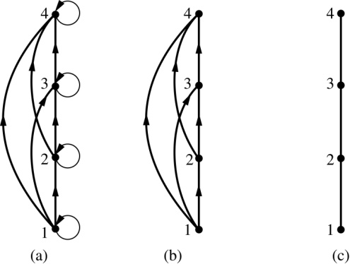
Hasse Diagrams
Definition: A Hasse diagram is a visual representation of a partial ordering that leaves out edges that must be present because of the reflexive and transitive properties.
A partial ordering is shown in (a) of the figure above. The loops due to the reflexive property are deleted in (b). The edges that must be present due to the transitive property are deleted in (c). The Hasse diagram for the partial ordering (a), is depicted in (c).

Slide 21
Procedure for Constructing a Hasse Diagram
To represent a finite poset (S,≼ ) using a Hasse diagram, start with the directed graph of the relation:
  Remove the loops (a, a) present at every vertex due to the reflexive property.
  Remove all edges (x, y) for which there is an element z ∈ S such that x ≺ z and z ≺ y. These are the edges that must be present due to the transitive property.
  Arrange each edge so that its initial vertex is below the terminal vertex. Remove all the arrows, because all edges point upwards toward their terminal vertex.

